Slide 1

PureScript
LA PureScript
Purely Functional Coding
Sean Westfall
Twitter: @alphonse86
Website: fieldsofgoldfish.github.com

Slide 2

Shout out to Carlo Flores, RIP

Slide 3
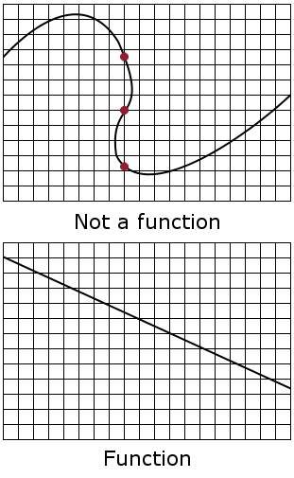
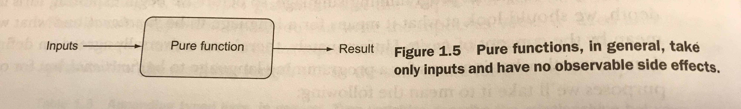
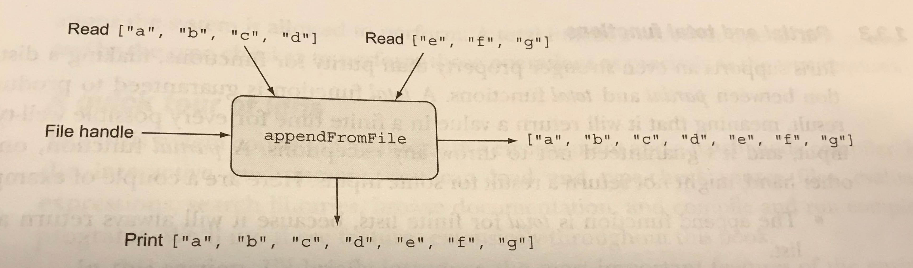
What is “Pure” Functional Programming?

Slide 4
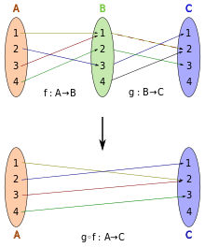
Function Composition

Slide 5
Pure Functional vs Functional vs Imperative
(define (factorial n)(define (iter product counter)(if (> counter n)product(iter (* counter product)(+ counter 1))))(iter 1 1))
Here successive evaluations of the same expression yield different values. This behavior arises fromthe fact that the execution of assignment statements (in this case, assignments to the variablebalance) delineates moments in time when values change. The result of evaluating an expressiondepends not only on the expression itself, but also on whether the evaluation occurs before or afterthese moments. Building models in terms of computational objects with local state forces us toconfront time as an essential concept in programming.
(define (factorial n)(let ((product 1)(counter 1))(define (iter)(if (> counter n)product(begin (set! product (* counter product))(set! counter (+ counter 1))(iter))))(iter)))
Function factorial(n) {
Var product = 1;
Var counter = 1;
While(counter > n) {
product = product * counter;
counter = counter + 1
}
Return n;
}
(set! counter (+ counter 1))(set! product (* counter product))

Slide 6
Why JavaScript is not Purely Functional
xs.map(first).map(second) → x.map(function(x){ return second(first(x)); })
var state = 0; function first(i){ return state += i; } function second(i){ return i `mod` state; }
var state = 0;
function first(i){ return state += i; }
function second(i){ return i % state; } [1,2,3,4].map(first).map(second)
[1, 3, 6, 0]
var state = 0;
function first(i){ return state += i; }
function second(i){ return i % state; }
[1,2,3,4].map(function(x){ return second(first(x)); })
[0, 0, 0, 0]

Slide 7
Introducing PureScript

Slide 8
Example #1: FizzBuzz
module Main where
import Prelude
import Control.Monad.Eff.Console (log)
import Data.Array ((..))
import Data.Traversable (traverse)
fizzBuzz :: Int -> String
fizzBuzz n = show n <> " " <> part "fizz" 3 <> part "buzz" 5
where
part s m | n `mod` m == 0 = s
| otherwise = ""
main = render =<< withConsole do
traverse (log <<< fizzBuzz) (1 .. 100)

Slide 9
Example #2: is a Palindrome
import Prelude
import Control.Monad.Eff.Console (log)
import Data.Array ((..))
import Data.Traversable (traverse)
import TryPureScript
import Data.String (length)
isPalindrome :: String -> Boolean
isPalindrome x | length x <= 1 = true
| head x == last x = isPalindrome . tail . init x
| otherwise = false

Slide 10
Example #3: is a Anagram
import Prelude
import Control.Monad.Eff (Eff)
import Control.Monad.Eff.Console (CONSOLE, logShow)
import Data.List (List(..), (:), filter)
import Data.List as S
import Data.String (toCharArray)
import TryPureScript (render, withConsole)
main = render =<< withConsole do
let anagram1 = toCharArray "eleven plus two"
let anagram2 = toCharArray "twelve plus one"
let sortedAnagram1 = quicksort (S.fromFoldable anagram1)
let sortedAnagram2 = quicksort (S.fromFoldable anagram2)
if sortedAnagram1 == sortedAnagram2 then logShow "true" else logShow "false"
quicksort :: forall a. Ord a => List a -> List a
quicksort Nil = Nil
quicksort (x:xs) = (quicksort lesser) `append` (x : quicksort greater)
where
lesser = filter (\n -> n < x) xs
greater = filter (\n -> n >= x) xs

Slide 11
Example #4: Binary Search Tree

Slide 12
Example #5: Fibannaci sequence

Slide 13
TypeClasses

Slide 14
Controlling Effects with Monads

Slide 15
Applicative Functors

Slide 16
`do` notation

Slide 17
TypeScript and the type Maybe<T> = T

Slide 18
Facebook Flow and Maybe & Any Types

Slide 19
Monads in JavaScript
// var ajax = MONAD()
// .lift('alert', alert);
// var monad = ajax("Hello world.");
// monad.alert();
// var maybe = MONAD(function (monad, value) {
// if (value === null || value === undefined) {
// monad.is_null = true;
// monad.bind = function () {
// return monad;
// };
// return null;
// }
// return value;
// });
// var monad = maybe(null);
// monad.bind(alert); // Nothing happens.
/*jslint this */
function MONAD(modifier) {
'use strict';
// Each unit constructor has a monad prototype. The prototype will contain an
// is_monad property for classification, as well as all inheritable methods.
var prototype = Object.create(null);
prototype.is_monad = true;
// monad.js
// Douglas Crockford
// 2016-01-27
// Public Domain
// The MONAD function is a macroid that produces monad constructor functions.
// It can take an optional modifier function, which is a function that is
// allowed to modify new monads at the end of the construction processes.
// A monad constructor (sometimes called 'unit' or 'return' in some mythologies)
// comes with three methods, lift, lift_value, and method, all of which can add
// methods and properties to the monad's prototype.
// A monad has a 'bind' method that takes a function that receives a value and
// is usually expected to return a monad.
// var identity = MONAD();
// var monad = identity("Hello world.");
// monad.bind(alert);

Slide 20
// If MONAD's modifier parameter is a function, then call it, passing the monad
// and the value.
if (typeof modifier === 'function') {
value = modifier(monad, value);
}
// Return the shiny new monad.
return monad;
}
unit.method = function (name, func) {
// Add a method to the prototype.
prototype[name] = func;
return unit;
};
unit.lift_value = function (name, func) {
// Add a method to the prototype that calls bind with the func. This can be
// used for ajax methods that return values other than monads.
prototype[name] = function () {
return this.bind(func, arguments);
};
return unit;
};
unit.lift = function (name, func) {
// Each call to MONAD will produce a new unit constructor function.
function unit(value) {
// Construct a new monad.
var monad = Object.create(prototype);
// In some mythologies 'bind' is called 'pipe' or '>>='.
// The bind method will deliver the unit's value parameter to a function.
monad.bind = function (func, args) {
// bind takes a function and an optional array of arguments. It calls that
// function passing the monad's value and bind's optional array of args.
// With ES6, this horrible return statement can be replaced with
// return func(value, ...args);
return func.apply(
undefined,
[value].concat(Array.prototype.slice.apply(args || []))
);
};

Slide 21
// Add a method to the prototype that calls bind with the func. If the value
// returned by the func is not a monad, then make a monad.
prototype[name] = function () {
var result = this.bind(func, arguments);
return (result && result.is_monad === true)
? result
: unit(result);
};
return unit;
};
return unit;
}

Slide 22
Functors

Slide 23
Applicative Functors

Slide 24
Monoid

Slide 25
Monads

